Slide 1
G8 Cars Online
Design and Developed by,
Kashish Bhanushali 16
Bindiya Chaudhari 30
Riddhi Chirmade 46
rohini narjhede 104
Preeti Pardeshi 117
Ganesh Saini 163

Slide 2
Agenda
Introduction to Project
Need of the project
Software & Hardware Requirements
ER Diagram
DFD 0 Level Diagram
DFD 1st Level Diagram
SnapShots
Conclusion

Slide 3
Introduction To Project
The title of the project is “G8 Cars Online”. It is an online system through which clients can view available cars, signup, login, view profile and book car. They even do not need to drive themselves driver is available with car. Prices are very less with all comfort.
This application Online Car Rental System require a temporary vehicle, for example those who do not own their own car, or owners of damaged or destroyed vehicles who are awaiting repair or insurance compensation or travelers who are out of town.

Slide 4
Need of the project
The new system is totally computerized system.
Anew system provides features like time efficiency to show car details, user
profiles and whatever the customer will give the feedback to the admin.
This system provides tourism and travelling facilities.
An inquiry is easily done by user in the system.
It is the most software application for managing online car rental business.

Slide 5
Software & Hardware Requirements
Software Requirement:
Wamp , Windows Vista, Win 7
Server 2.5 or above.
My SQL Server.
Hardware Requirement:
Processor – 2.5 GHZ
Ram – 2 GB MB.
Hard Disk-50 GB

Slide 6
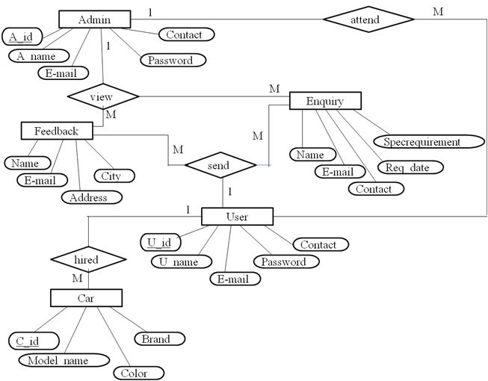
ER Diagram

Slide 7
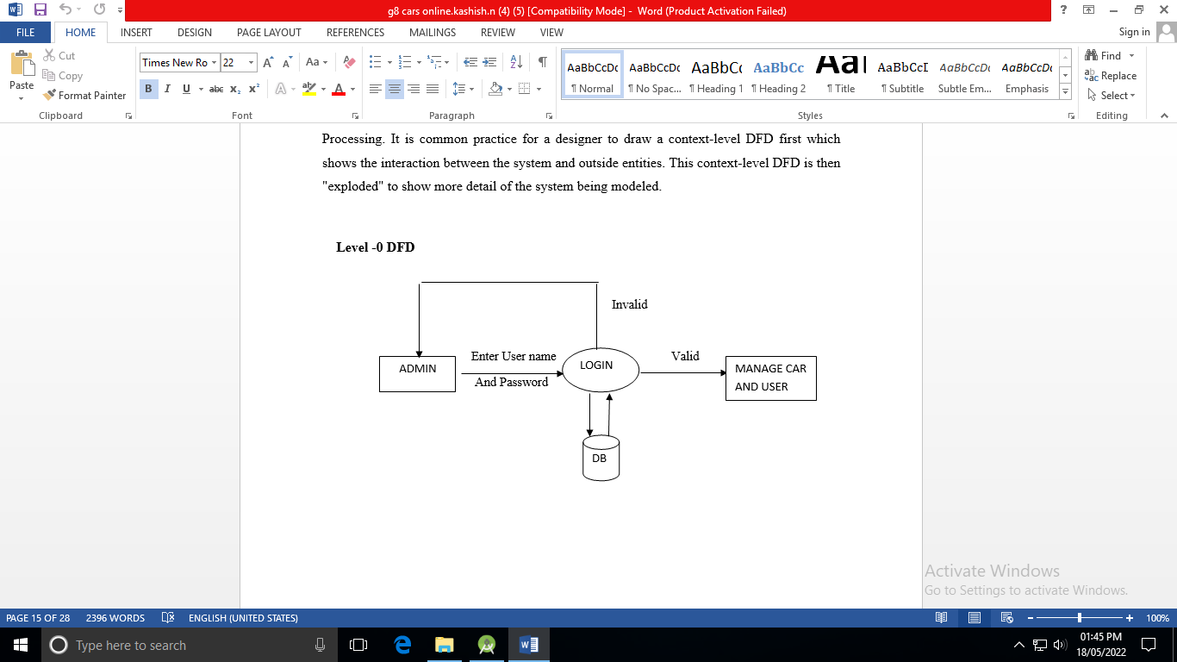
DFD 0 Level

Slide 8
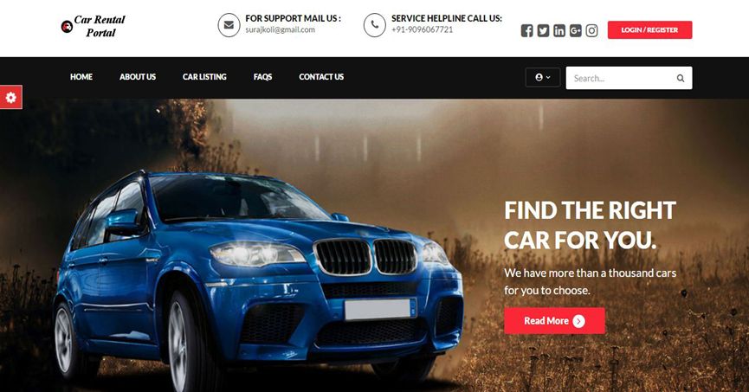
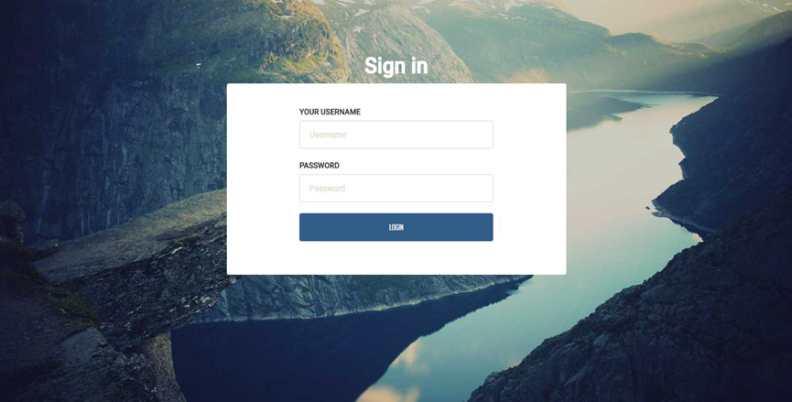
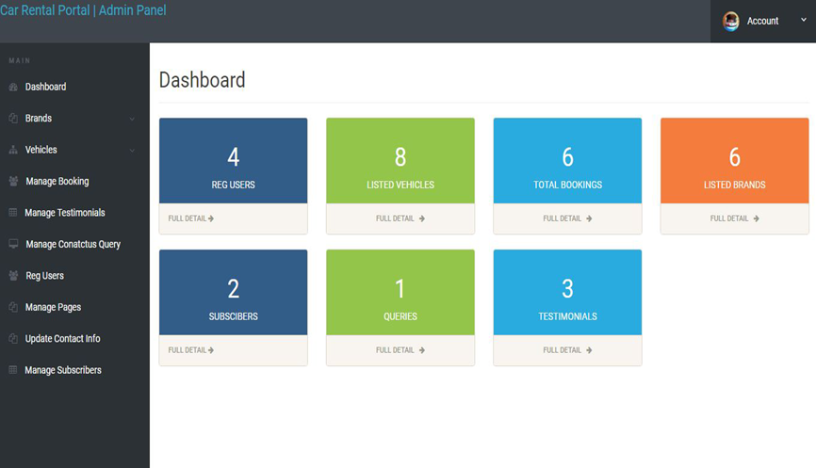
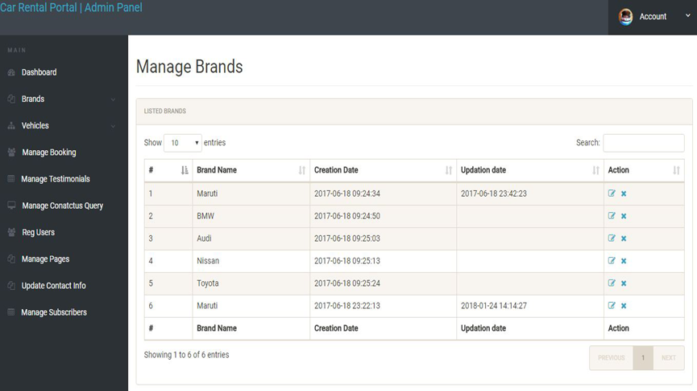
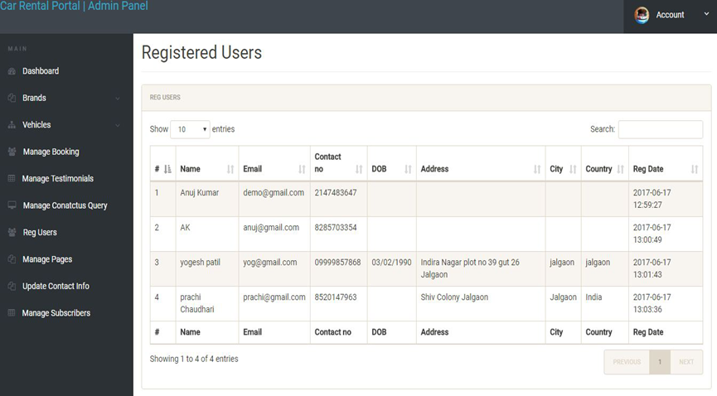
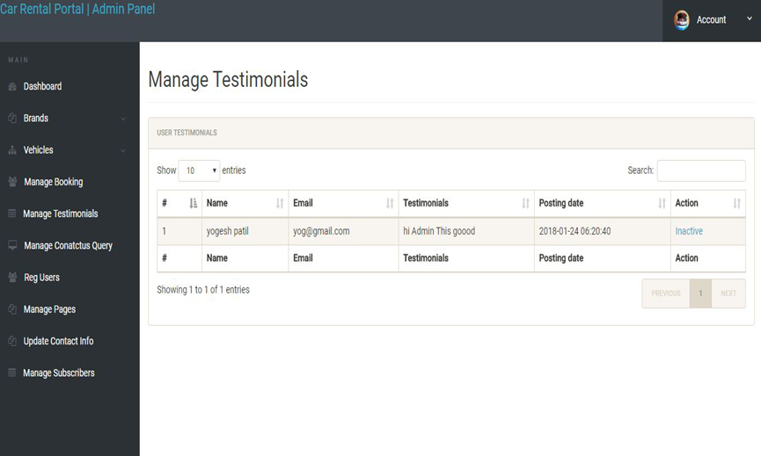
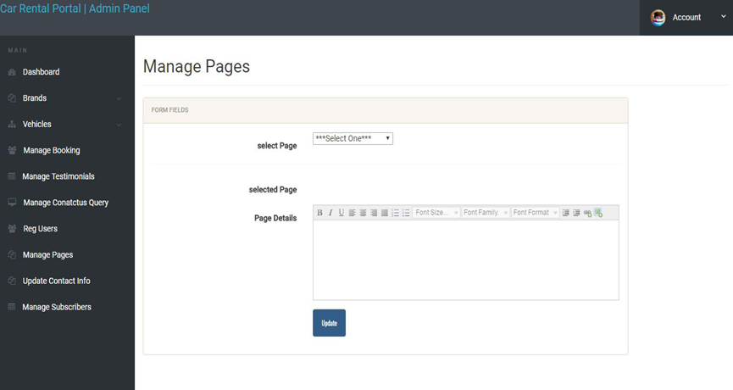
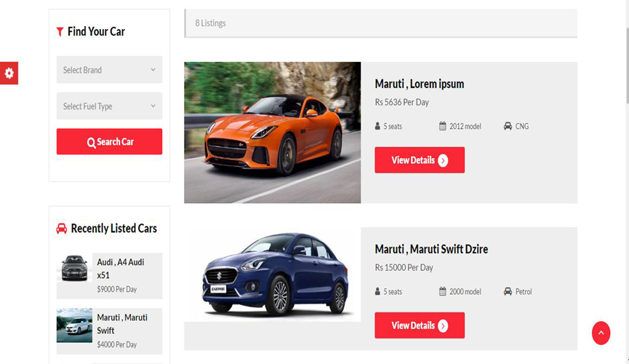
Snap Shots

Slide 9
Conclusion
In car rental business has emerged with a new goodies compared to the past experience where every activity concerning car rental business is limited to a physical location only even through the physical location has not been totally eradicated.

